Slide 1
BONGA VISIBILITY DASHBOARD - PROJECT CHARTER
Background | Scope | High-Level Risk / Assumptions
Timely and accurate material planning is critical to avoiding costly operational disruptions. The Bonga Visibility Dashboard initiative aims to address significant challenges related to Material on Time (MOT) delivery, with the goal of mitigating issues affecting production, safety, and environmental compliance resulting from critical material unavailability. To prevent such occurrences and enhance overall material management processes, the Bonga Visibility Dashboard is designed to provide end-to-end visibility into the lifecycle of material requests. It tracks the creation of PRs, monitors their conversion into POs, and follows through to supplier delivery, aligning with the ZExpedite system for real-time tracking at the supplier delivery level. Moreover, the dashboard will play a critical role in monitoring and ensuring the availability of critical materials by retrieving critical material data from SAP. This data supports MRP and other business units in maintaining a dependable supply of critical components. The dashboard provides visibility into the availability of critical stock items designated in SAP, triggering MRP to raise PRs for those falling below minimum stock levels. Subsequently, it tracks the creation of PRs and monitors their conversion to POs within defined SLAs. The development of this dashboard aims to not only track PR to PO cycle times and ensure compliance with SLAs but also to foster a robust review system for critical stock items, ensuring that they are always available to prevent future operational disruptions. | Dashboard development Visualization Documentation Quality assurance Change Management | Risks/Dependencies Timelines for project set up and deployment and cost. Availability of data to deliver on time. System integration. Mitigations. Secure clear scope of work from business stakeholders and draft resource plan. Ensure a flexible architecture for E2E material monitoring. Develop bots to help with data upload and system integration. Assumptions All costs are sunk costs and appear for record purposes.
Objectives | Deliverables | Key Activities / Timeline / Estimates
Enhance Material Planning and critical materials availability. Develop and deploy a one-stop repository that tracks E2E materials process. Provide comprehensive real-time visibility into all SCiN material requests, ensuring all stakeholders are informed and can act promptly. Establish quantifiable metrics to measure improvements in the materials cycle. Facilitate better decision-making through the use of detailed analytics and reporting features that track material request and fulfillment patterns. | Requirement gathering System Deployment System Documentation Change management | Key Activities/Timeline - Refer to slide ‘Plan on A Page’.
Benefits | Costs | Team / Stakeholders
Improved on time delivery of critical materials. Reduction in rush – orders and fire fighting. Improved worker productivity. Provides insight for CP leadership into all materials in SCiN Improves the end-to-end materials management process. |  | Stakeholders – Refer to slide ‘Project Governance’ Project Team Project Manager Business Analyst Technical Analysts Change Focal
SG1 & SG2 | April-May 2024
SG 3 & SG4 | June 2024
Go Live | July 2024
SG5 & SG6 | July 2024
Budget | 2024
Development | 50K
License Required | 6K
Total | 56K

Slide 2
Plan On A Page
Acronyms:
SG – Stage Gate
UAT – User Acceptance Testing
ITC – Integration test Cycle
Project Set Up & Define
We are here
SG1 SG2
Project Set Up & Requirements gathering
Design/ Build
SG3
Development
ITC
SG4
ITC
UAT / Regression
UAT
Go-live & PGLS
Hyper care
SG5
SG6
Project Closure
Closeout
April
May
May
June
June
July
July
2024
Go-live

Slide 3
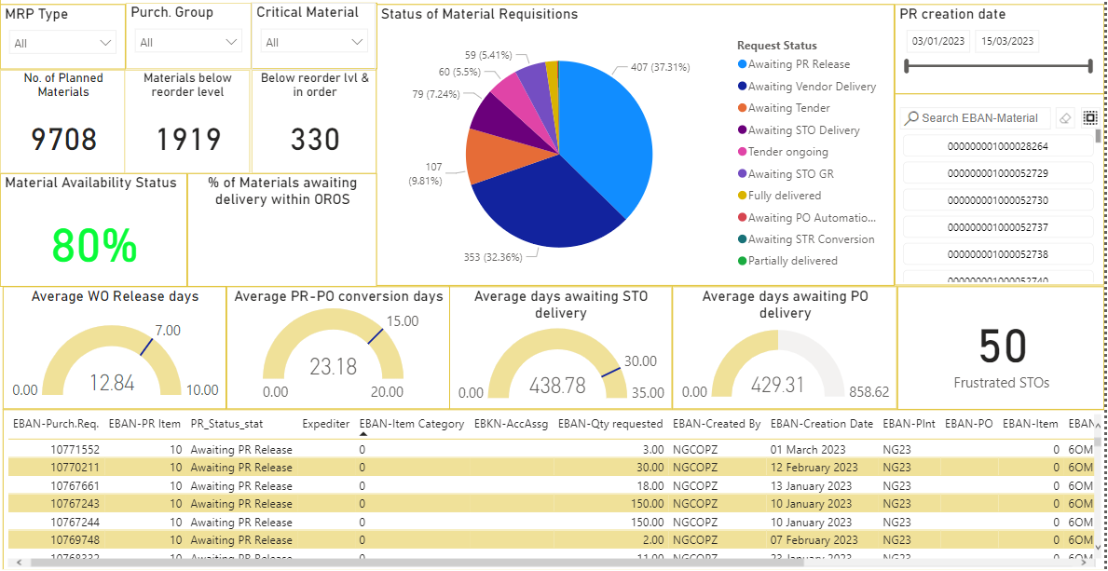
Sample Dashboard

Slide 4
PROJECT GOVERNANCE
Direction & Decision
Status Update & Escalation
Provide overall direction for the project
Review and approve scope changes with budget impact<=10%
Provide project decision on critical and showstopper issues impacting go-live
Provide final approval for PDF stage gates
Steering Committee
George Chukwumah – WPS Lead/Maintenance Planner
Belema Agala – Operations Support Lead (Bonga)
Atebe Orobome – Bonga Maintenance Manager
Oluwaseun Akinyemi – Head, Campaign Maintenance
Nwanne Nkiru- SC RtP Manager
Manage project delivery, timeline and budget as per schedule
Identify project risks, issues and resolutions
Escalate critical project risks and issues
Project Team
Project Manager
Change Lead
Business Analyst
Technical Analyst/Developer
Functional Analysts
4

Slide 5
Project Organization
Project Management
Local Steering Committee
SC Project Manager
Dafe Isodje
PMO Analyst Seun Oshin
Managers
George Chukwumah
Belema Agala
Atebe Orobome
Oluwaseun Akinyemi
Nkeiruka Nwanne
Analyst
Business Analyst/Improvement
Development Team
SME:
Adrian Okpere
Keme Bomo
Imoh Odoro
Wilson Itodo
Change Management
Dafe Isodje
Seun Oshin
Adelabi Giwa
Oyinkansade Ayo-Aderele
Nkechi Nwafor
Developer:
Dafe Isodje
Seun Oshin
Adelabi Giwa
Oyinkansade Ayo-Aderele

